Slide 1
“Something is Just not Right”
Christmas 2017
A free CD of this message will be available following the service …
… or you may download the podcast later this week from calvaryokc.com

Slide 2
msnbc.com
20%
40%
60%
80%
Jesus lived 93%
Son of God 82%
Virgin birth 79%
Bible accurate 55%
Jesus will return 52%
In their lifetime 15%
Less kindness 61%
More war 47%
Creation Science 62%
C/S exclusively 43%
Reflects Christian values 11%
“Something’s Just not Right”

Slide 3
“Something’s Just not Right”

Slide 4
Christ
mas
X
reason
Jesus is the for the Season
“Something’s Just not Right”
This Photo by Unknown Author is licensed under CC BY-NC-ND

Slide 5
“Something’s Just not Right”

Slide 6
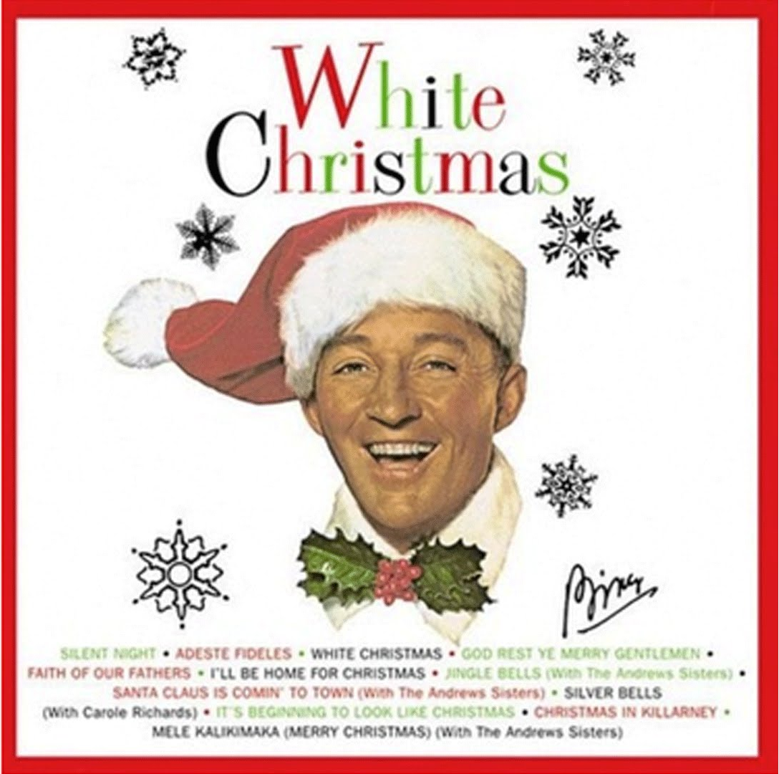
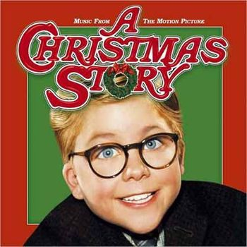
“Something’s Just not Right”

Slide 7
“Something’s Just not Right”

Slide 8
“Something’s Just not Right”

Slide 9
Matt. 5:14 ~ You are the light of the world. A city that is set on a hill be hidden.
cannot
“Something’s Just not Right”
This Photo by Unknown Author is licensed under CC BY-NC-ND

Slide 10
“Something’s Just not Right”

Slide 11
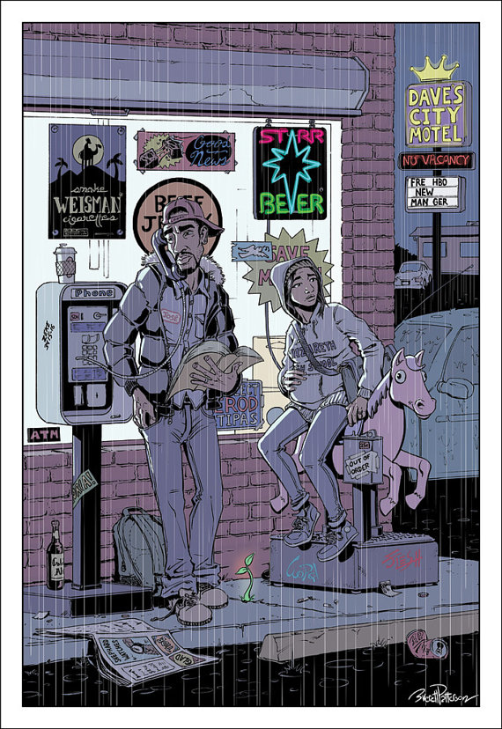
“Something’s Just not Right”
This Photo by Unknown Author is licensed under CC BY-NC-ND

Slide 12
John 8:39b-41 ~ ^{39b} Jesus said to them, “If you were Abraham's children, you would do the works of Abraham. ⁴⁰ But now you seek to kill Me, a Man who has told you the truth which I heard from God. Abraham did not do this. ⁴¹ You do the deeds of your father.”
Then they said to Him, “We were not born of fornication; we
have one Father — God.”
“Something’s Just not Right”

Slide 13
“Something’s Just not Right”

Slide 14
We want
the warmth of Christmas
without the Source of the heat
the “spirit” of Christmas
without Spirit of God
the “purpose” of the holiday
without the Person of the holiday
the Season
without the Reason
“Something’s Just not Right”

Slide 15
“Something’s Just not Right”

Slide 16
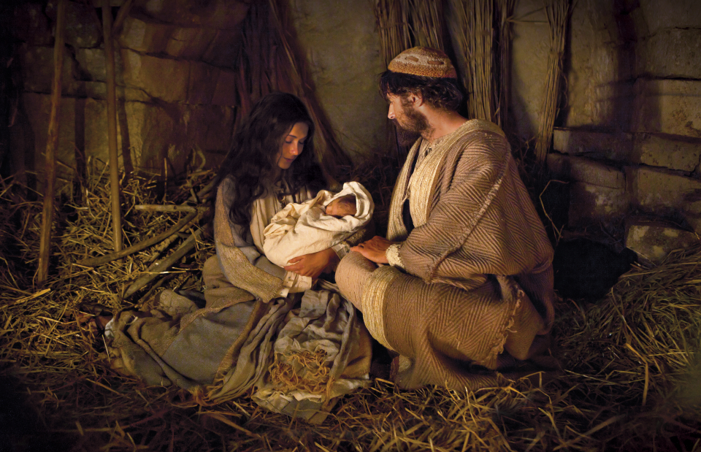
They never mentioned His name. Doesn’t it seem odd for people to go to all that trouble to celebrate someone’s birthday if they don't know Him? I had the strangest feeling that if our Son had gone to this celebration He would have been intruding.
They wrapped them in beautiful paper and tied them with lovely bows and stacked them under a tree. Yes, a tree, Joseph, right in their house. They’d decorated the tree also. The branches were full of glowing balls and sparkling ornaments.
I had a dream, Joseph. I don’t understand it, not really, but I think it was about a birthday celebration for our Son. I think that was what it was all about. The people had been preparing for it for about six weeks.
They had decorated the house and bought new clothes. They’d gone shopping many times and bought elaborate gifts. It was peculiar, though, because the presents weren’t for our Son.
There was a figure on the top of the tree. It looked like an angel might look. Oh, it was beautiful. Everyone was laughing and happy. They were all excited about the gifts. They gave the gifts to each other, Joseph, not to our Son. I don’t think they even knew Him.
Everything was so beautiful, Joseph, and everyone so happy, but it made me want to cry. How sad for Jesus – not to be wanted at His own birthday party. I’m glad it was only a dream. How terrible, Joseph, if it had been real.
“Something’s Just not Right”

Slide 17
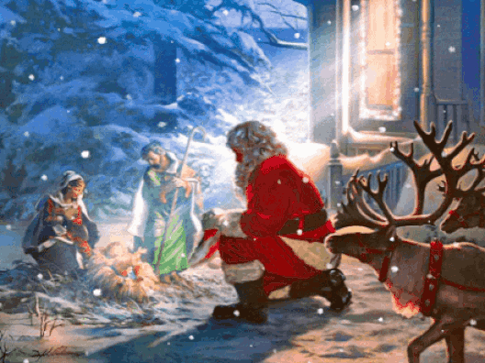
“Something’s Just not Right”

Slide 18
“Something’s Just not Right”

Slide 19
John 10:27-33 ~ ²⁷ My sheep hear My voice, and I know them, and they follow Me. ²⁸ And I give them eternal life, and they shall never perish; neither shall anyone snatch them out of My hand. ²⁹ My Father, who has given them to Me, is greater than all; and no one is able to snatch them out of My Father’s hand. ³⁰ I and My Father are one.”
“Something’s Just not Right”

Slide 20
John 10:27-33 ~ ³¹ Then the Jews took up stones again to stone Him. ³² Jesus answered them, “Many good works I have shown you from My Father. For which of those works do you stone Me?”
³³ The Jews answered Him, saying, “For a good work we do not stone You, but for blasphemy, and because You, being a Man, make Yourself God.”
“Something’s Just not Right”

Slide 21
“Something’s Just not Right”

Slide 22
“βββψψψχγχγχγχγχ”
“Something’s Just not Right”

Slide 23
“Something’s Just not Right”

Slide 24
Heb. 2:14-15 (Phillips) ~ ¹⁴ Since, then, “the children” have a common physical nature as human beings, he also became a human being, so that by going through death as a man he might destroy him who had the power of death, that is, the devil; ¹⁵ and might also set free those who lived their whole lives a prey to the fear of death.
“Something’s Just not Right”

Slide 25
“Something’s Just not Right”

Slide 26
1 John 3:8 ~ He who sins is of the devil, for the devil has sinned from the beginning. For this purpose the Son of God was manifested, that He might destroy the works of the devil.
“Something’s Just not Right”

Slide 27
destroy ~ luō – to loose or untie
raise ~ to erect or build; to cause to arise, appear or exist
Born to
Raise
Raze
raze ~ to level to the ground, to demolish
Hell
“Something’s Just not Right”

Slide 28
“Something’s Just not Right”

Slide 29
Billy Graham ~ “The very purpose of Christ's coming into the world was that he might offer up his life as a sacrifice for the sins of men. He came to die. This is the heart of Christmas.”
“Something’s Just not Right”

Slide 30
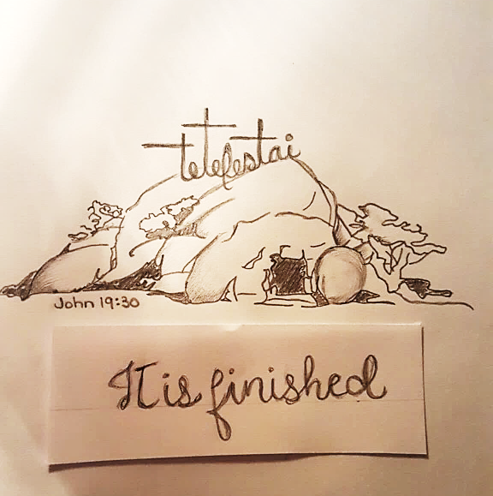
Is. 9:6 ~ For unto us a Child
is born,
Unto us a Son is given;
And the government will
upon His shoulder.
And His name will be called
Wonderful, Counselor, Mighty
God, Everlasting Father,
Prince of Peace
© Hope Carney (with permission)
“Something’s Just not Right”

Slide 31
“Something’s Just not Right”

